Slide 1



ESG CENTRIC
QUALITY ENGINEERING SERVICES

Slide 2

We recognize the importance of the global Sustainable Development Goals and are dedicated to making a positive impact through our ESG centric QE services
KPMG's Quality Engineering practice is dedicated to supporting the Global Sustainable Development Goals by offering ESG centric Quality Engineering services and aligning the activities with client specific ESG strategies and objectives.

Slide 3

ENVIRONMENTAL IMPACT DUE TO QE ACTIVITIES

Slide 4

Environmental Impact
Our approach prioritizes minimizing carbon footprint by optimizing Quality Engineering activities, which enables responsible consumption of storage space and reduced hardware and power usage, all without compromising on the quality of outcomes.
Test Environment management
Optimum usage of infrastructure and test environments
Test Data management
Tooling approach and standardization
Cloud computing and IAC
Early identification of defects thru shift left activities
Virtualization
Capture NFRs including sustainability goals
Do right amount of testing
Context based Risk Based Testing approach
Opkey Reusable assets for Powered testing
Focus on maximizing reusability
KPMG Innovation approach
KPMG Automation approach
Improve efficiency in test scripts development
Minimize redundancy
Script less/ Low code platforms & automation tools
Generative AI for Test design & execution

Slide 5

SOCIAL IMPACT BY KPMG QE TEAM

Slide 6

Social Impact
We generate a positive social impact by organizing, training, and upskilling our Quality Engineering team to support diverse groups through our testing services and by actively engaging in corporate social responsibility initiatives.
IDE Initiatives
Inclusion, Diversity and Equity
Multi Geography collaboration / GDM
Diversity in hiring
Corporate Social Responsibility initiatives
Focus on CSR activities
Accessibility Testing
Fairness testing
QE services that support diverse groups
UI/UX, Multi device/browser testing
Security testing
TDM for secured data
Women empowerment
WE@Consulting initiative
Trainings based on latest Market trends
Trainings to upskill team members
ESG Centric QE trainings

Slide 7

GOVERNANCE IMPACT BY KPMG QE ACTIVITIES

Slide 8

Governance Impact
Our governance process emphasizes the prevention of potential risks, reduction of quality-related costs, adherence to high-quality standards, and comprehensive ESG reporting to maintain transparency and accountability.
Delivery risk Predictability model
Proactive Delivery Risk management
Project risk dashboard
Sustainable SDLC
Controlled access for work done remotely
Metrics/SLA/KPI management
Well defined QE metrics
Strategies aligned with market trends
QE Practice strategies
ESG inclusion in Test strategy and reporting
Test Maturity Assessment
Test Consulting
Defect Management
ESG Report testing
ESG report testing

Slide 9

ENVIRONMENTAL IMPACT - DETAILED SLIDES

Slide 10





Test Environment management
Effective Test Environment Management (TEM) contributes to reducing CO2 footprint by optimizing resource utilization, enhancing well-being through effort streamlining, and bolstering governance efficiency while maintaining high-quality output
ESG Benefits
01
Estimation Portal
Gather environment requirements and produce environments strategy
Captures TEMS engagement effort estimates from testing project requirements
02
Environment Portal
Environment bookings
Contention Management and Tracking progress
Provides platform to multiple stakeholders to submit – view - change and approve bookings
Optimize environment resource usage
Streamlined test environment usage leads to reduced storage space requirements.
Decreased test environment downtime ensures more efficient resource time utilization.
Enhanced productivity and quality are achieved through robust governance practices.
Greater adoption of cloud-based platforms contributes to a reduction in CO2 emissions.
Process 2
Process 1
KPMG Test
Environment Management
Process 3
05
Environment Dashboard
Visibility of the environment status
Track progress of critical TEMS activities like P1 & P2 Incidents
Open defects, service requests and environment calendar
03
Change Management Portal
Manage change requests
Manage environment outages
Control changes to test environment resources to ensure integrity and availability of environments
Handle tickets related to environmental issues and follow up with resolver groups
Process 5
Process 4
04
Automation Desk
Daily health check scripts
Automatic addition of roles and ID creation
Automated mailers for event
Build, execute and monitor batch processes
Plan and schedule batch runs and data refresh

Slide 11







Test Data management
At KPMG, we provide Test Data Management services using both traditional methods and advanced techniques utilizing automated Test Data Automation platforms. Our primary goals encompass optimizing test data storage consumption and adhering to privacy regulations to safeguard sensitive information.
Protecting data privacy laws in traditional approach
Usage of automated Synthetic Test data generating tools like
ESG Benefits
Traditional approach
Optimizes test data storage consumption to minimize carbon footprint.
Removes all personally identifiable information (PII) from test data, ensuring full compliance with security regulations.
Reduces cost and effort across multiple projects.
Enhances speed and accuracy in test data creation and maintenance processes.
Maintain Gold copy of test data and test data scripts
SPEED: Ability to extract table schema and provision real-time synthetic data at high speed.
Test data provisioning/ requisition and Data refresh
KPMG Test
Data Management
COST: Minimum cost for provisioning data through on-demand generation of data.
Test data updating and maintenance.
Data mining to ensure data coverage based on reservations.
QUALITY: Complete, controlled, conditioned data to maximize coverage and accuracy.
Perform data aging, archiving and recall.
SECURITY: Adherence to data privacy laws such as GDPR, PCI and HIPAA.
Ensure optimized test data storage consumption
USABILITY: Easy to use platform for provisioning data on-demand.
Automation of TDM activities
VERSETILITY: Ability to provision data in any format including legacy data formats.
* Test data extraction from production and data masking are done by client IT team
ESG Centric approach

Slide 12







Tooling approach and standardization
At KPMG, we have implemented a standardized process that incorporates a shared set of tools and utilities for quicker turnaround times and minimal wastage of tools and licenses. This approach contributes significantly to reducing our overall carbon footprint.
We strongly believe that it is worth evaluating already existing tools instead of reinventing the wheel. We follow below six steps to identify/create and standardize tools
ESG Benefits
Maximizing reusability, which minimizes wastage of tools and licenses.
ROI-based tool analysis contributes to reducing the cost of tools and operations.
Developing new tools and utilities fosters innovation within the organization.
03
Licensed tools
In case no internal tools are suitable, evaluate fitment of licensed tools
04
Freeware Vs Licensed tool
Compare both freeware and licensed tools and select the right tool based on fitment and ROI
02
Freeware tools
In case no internal tools are suitable, evaluate fitment of freeware tools
05
Build Inhouse tool
In case no tool fits the requirement or ROI is not as expected, consider developing inhouse tool by applying KPMG specific design thinking approach.
01
Internal tools
Evaluate fitment of tools that are already procured by the client
06
Tools Standardization
Standardize the tools across the enterprise by conducting POC and looking for requirements for tool viability in ongoing projects
KPMG Approach for
Tools Standardization

Slide 13



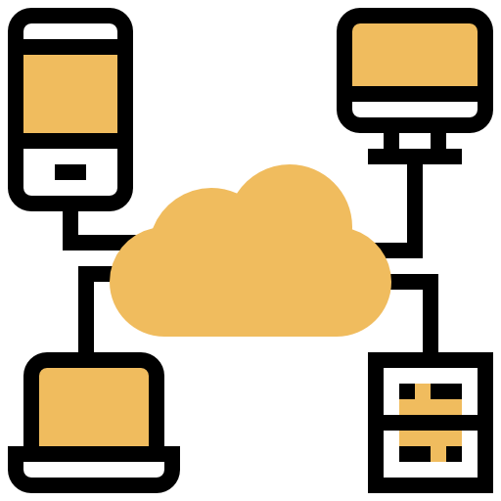


Cloud computing and IAC
To accelerate digital transformations via cloud technologies, we developed industry-specific, end-to-end automated test suites for cloud computing and Infrastructure as Code (IAC) testing. This approach maximizes asset reuse and enhances ROI. Through IAC, coupled with automated provisioning, we employ automated configuration and testing for the deployment of applications onto servers, streamlining operations and ensuring reliability.
ESG Benefits
KPMG Cloud computing & IAC Testing Services
Enhances scalability
Fosters innovation and collaboration.
Improves resource efficiency
Facilitates anytime, anywhere operations through seamless connectivity.
Reduces energy consumption, contributing to environmental sustainability.
Achieves a high level of reusability across multiple platforms, aiding in the reduction of carbon footprint.
Performance/Scalability
Extreme Automation
Performance Testing
Load Testing
Stress Testing
Endurance Testing
Automated testing in CI/CD pipeline
Automated QA env provisioning
Security and Data
Mobile and Web
Penetration testing
Data security and privacy
Data migration testing
Automated UI and Functional Testing
Cross-browser and multi-device testing
APIs & Integrations
Resiliency and Recovery
Integration Testing
Contract Testing
End to End Testing
Test Automation
Chaos Engineering
Failover Testing
Disaster recovery testing

Slide 14







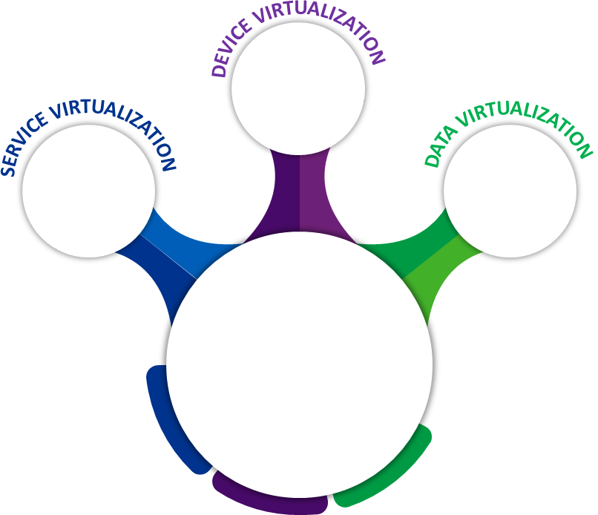











Virtualization
KPMG's virtualization services encompass Service, Device, and Data virtualization to reduce testing costs by minimizing dependency on the availability of upstream and downstream applications, devices, and data. This approach enables more efficient testing processes and resource utilization.
ESG Benefits
Cloud Device Simulator tools
Reduces carbon footprint by minimizing the use of multiple devices.
Decreases downtime caused by unavailability of applications, devices, or data.
Improves efficiency and productivity throughout the testing process.
Offers scalable simulations, such as virtual IoT devices.
Enables remote testing without dependency on physical devices.
Lowers overall testing costs.
Virtual Clone 1
Virtual Clone 2
Virtual Clone 3
MIDDLEWARE
RESTFUL SERVICES
Database
Virtualization
Engine
Communication
Channel
Legacy Systems
APPLICATION UNDER TEST
JDBC
API
JDBC/ API
Third party applications
On-premise databases
Cloud databases
Xls, CSV, JASON, XML etc

Slide 15










Capture NFRs including sustainability goals
We firmly believe that incorporating ESG goals into non-functional requirements is crucial for minimizing resource wastage, ensuring data protection, and designing applications that cater to the diverse needs of all individuals. This holistic approach promotes sustainability and inclusivity within our technology solutions.
ESG Benefits
SCALABILITY
Handling Current/Future Loads
Optimum use of resources
SECURITY
Role/Privilege based access
Data Encryption
Minimizes waste and encourages optimal usage of resources.
Enhances and diversifies the user experience.
Increases overall system quality.
Lowers risks by emphasizing resilience and disaster recovery.
Reduces hardware and software costs for better budget efficiency.
PERFORMANCE
Response Time
Bandwidth Constraints
MONITORING
Application Health Check
Utilization Monitoring
INTEGRATION
In-bound/out-bound Integration
Standards Compliance
ESG-DATA PROTECTION
Data Privacy
Data security
ACCESSIBILITY
Confirming to WCAG 2.1
Confirming to ADA Audit
ESG- WASTE MANAGEMENT
Data Redundancy
Infrastructure Planning
SLA Compliance
Offline Mode of Working
ESG- SUSTAINABILITY
Capacity Planning
Management, Risk Analysis
AVAILABILITY
Non- Functional Testing
Performance
Testing
Security
Testing
Accessibility
Testing
Compatibility
Testing

Slide 16






Context based Risk Based Testing approach
We firmly believe that the Risk-Based Testing (RBT) approach should be tailored to each specific project. Depending on various parameters within a project, we implement one of the six RBT approaches outlined in the below figure.
BUSINESS FUNCTIONS
Test cases are classified according to their corresponding business functions.
For each project, the business team provides a list of impacted business functions due to changes in the application.
Test cases are then executed based on the affected business functions, ensuring targeted and efficient testing.
TEST CASE CRITICALITY
Test cases are categorized into high, medium, and low criticality levels. As part of the RBT strategy, high-risk test cases are executed first, followed by medium and low critical test cases. This prioritization ensures that the most crucial aspects are addressed promptly and effectively.
ESG Benefits
Optimizes resource usage for testing, minimizing carbon footprint.
Implementing an RBT strategy helps identify critical or major risks early in SDLC.
Reduces project costs for better budget efficiency.
Minimizes project risks, particularly in situations where cost and schedule pressures exist.
Assists in prioritizing test cases for automation.
1
2
ORTHOGONAL ARRAY TECHNIQUES
By utilizing Orthogonal Array Techniques, the minimum number of test cases necessary for maximizing coverage is identified. This method ensures that testing is efficient and comprehensive while minimizing the resources required.
DEFECT PRONE AREAS
Leveraging historical defect data, test cases are classified as defect-prone. As part of the RBT strategy, these defect-prone test cases are executed first to address potential problem areas and enhance overall application quality.
3
4
COMBINATION APPROACH
Any combination of scenario 1,2,3 & 4.
E2E WORKFLOWS
As part of the RBT approach, automate 10 to 15 end-to-end critical workflows and execute them.
5
6

Slide 17

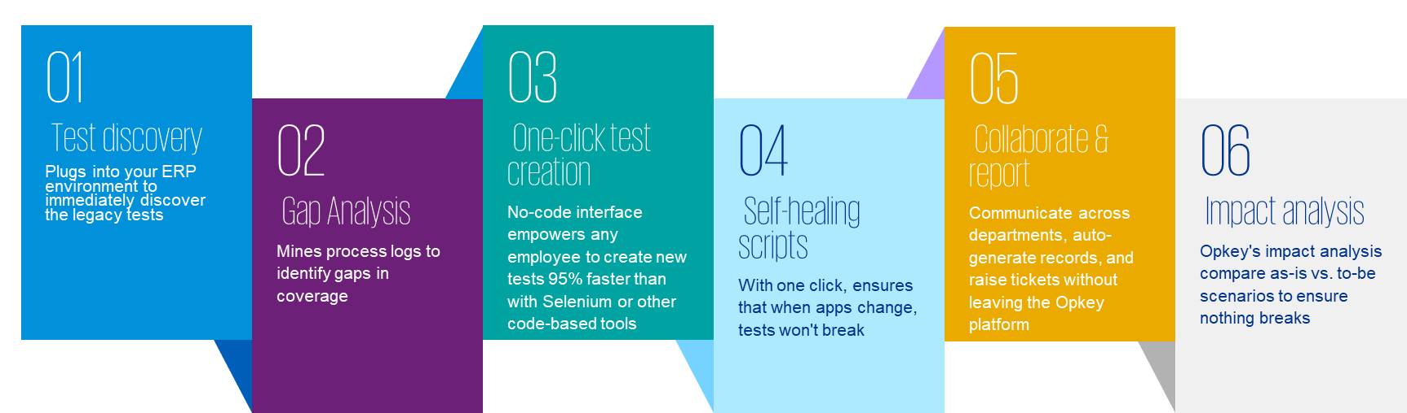







Opkey Reusable assets for Powered testing
KPMG's automation framework enables enterprises to keep up with accelerated release schedules while reducing risks, enhancing reusability, and ensuring business continuity. This comprehensive approach supports organizations in meeting their goals and delivering high-quality software solutions efficiently.
ESG Benefits
By automating process intelligence and testing, Opkey enables the world's largest enterprises to keep up with release schedules, minimize risks, and maintain business continuity.
Highly reusable components across multiple releases and regression cycles optimize resource utilization and storage space, enhancing efficiency.
Rapid implementation conserves considerable effort and cost, adding value to the project.
A SaaS-based platform allows for effective storage and management of scripts, streamlining the overall testing process.
4000+ reusable assets
700+ reusable assets
Under planning phase

Slide 18
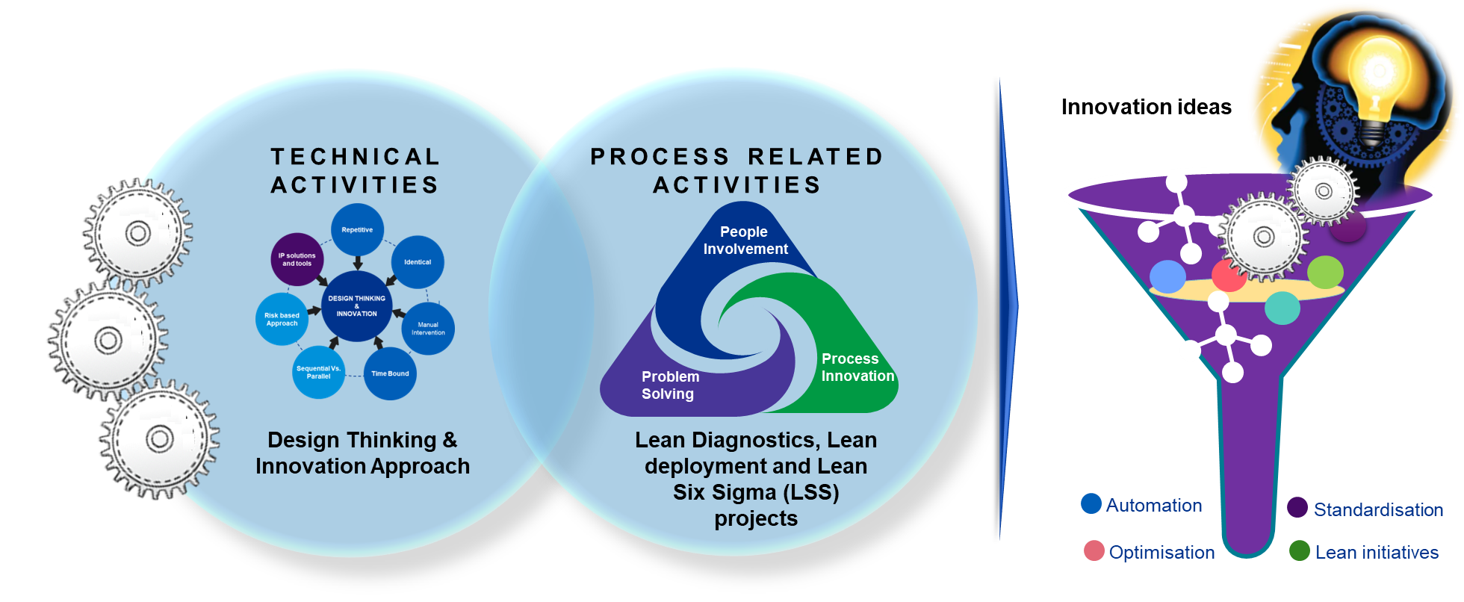
KPMG Innovation approach
At KPMG, we foster a culture of innovation through a structured approach. We identify innovation opportunities by employing the Design Thinking innovation methodology and incorporating Lean concepts. This proactive and creative mindset drives continuous improvement and problem-solving within the organization.
ESG Benefits
Optimized usage of resources for testing to minimize carbon footprint.
Saves cost to the project.
Helps in governing quality and continuous improvement
Eliminates non-value add processes.
Focuses on maximizing reusability

Slide 19
KPMG Automation approach
Our team adheres to a clearly defined automation strategy aimed at helping clients attain a quicker Return on Investment (ROI). This approach results in expanded automation coverage, cost reduction, and accelerated time to market. Furthermore, we utilize our in-house accelerators to efficiently pinpoint reusable components for automation, streamlining the process of scripting and maintenance efforts.
ESG Benefits
Key inputs
Decision making process for Automation
KPMG Accelerator
Optimized scripting effort saves storage space which helps to minimize carbon footprint.
Maximized reusability through creation of reusable components
Saves cost to the project.
Helps in prioritizing the Test cases for automation based on ROI and criticality of application.
Prerequisites and dependencies
---
Frequency of test execution
---
New Features/ Enhancements
---
Applications criticality
---
Historical defect trends
---
Time to market requirements
Is time to market critical for the application?
Yes
KPMG in-house tool to Identify common Test Steps/ components across huge repository of test cases. These reusable components identified would help optimize automation scripting and maintenance effort.
No
Yes
Is application being sunset soon?
No
Automation not recommended
Yes
Is application undergoing major modification?
Prioritize application for automation
No
No
Calculate Return on investment based on manual execution productivity, frequency, automation scripting/ execution/ maintenance effort estimated
No
Is ROI within acceptable limits?
No
Split Regression testing activities and identify activities that are taking considerable time. Calculate automation ROI.
No
Is ROI within acceptable limits?
Yes
Yes

Slide 20


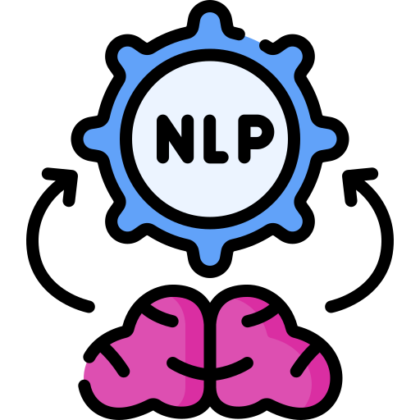


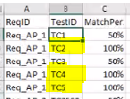





Minimize redundancy
At KPMG, we have developed an AI-enabled solution that has received CII award for its ability to proactively minimize redundancy in designing manual test cases based on requirements. This innovative solution also identifies reusable components across test cases, reducing scripting efforts during automation and streamlining the overall process.
KPMG AI Enabled Reusable Testcases & Components Identifier
ESG Benefits
Reduces redundancy in test case design.
Conserves storage space, thereby decreasing the carbon footprint.
Decreases maintenance efforts required.
Results in cost and effort savings for the project.
REQUIREMENTS
AI/ML MODELS
CORE ENGINE
OUTPUT
Sources
RAKE Algorithm
Reusable TCs with % match to requirements & Reusable components across TCs
*RAKE - Rapid Automatic Keywords Extract
Test cases repository

Slide 21

















Script-less / Low code platforms & automation tools
As we strive to maintain a lasting competitive advantage in the future, we deliver Quality Engineering services to our clients by employing script-less/low-code platforms and automation tools. This approach emphasizes maximizing reusability, accelerating time to market, and minimizing the carbon footprint, ensuring sustainable growth and success for our clients
LOW CODE PLATFORMS EXPERTISE
SCRIPT-LESS/ LOW CODE AUTOMATION TOOLS EXPERTISE
ESG Benefits
Enhances reusability, thereby lowering the carbon footprint.
Boosts efficiency in application development and testing processes.
Decreases automation scripting effort and associated costs.
Ease of maintenance.
Accelerates time to market.
Promotes improved sustainability practices.
Reduces reliance on highly technical resources, making the process more accessible.
Low Code automation platform for all packaged applications
ITSM, Operations, HR, CRM, Chatbot, Now Mobile, Field Service Management, GRC, Security etc
Low code Automation framework for ServiceNow platform
Automated Test Framework
HR, Finance, Banking, Health, Insurance etc
Script-less Automation tool for Appian automation
Insurance, Finance, Banking etc
Script-less Automation tool for functional automation
Insurance, Finance, Banking etc
Script-less Automation tool based on AI for functional & API automation

Slide 22



Generative AI for Test design & execution
At KPMG, we employ AI-based systems like ChatGPT to refine test design and execution activities. Although there are limitations to ChatGPT as an independent AI-based system, through its integration into our processes, ChatGPT streamlines test design and execution activities, leading to significant savings in time and resources while enhancing product quality.
Test Design
Test Execution
ESG Benefits
Maximizes reusability thus reducing carbon footprint.
Helps in minimizing redundancy in test assets.
Improves efficiency in test design and execution.
Reduces automation scripting effort and cost.
Ease of maintenance.
Faster time to market.
Improves quality of deliverables.
Improved sustainability
Reduces reliance on highly technical resources.
REQUIREMENTS ANALYSIS : extracts essential information to help testers design specific test cases
TEST AUTOMATION: generates scripts for automated test cases based on the test designs
GENERATE TEST CASES: generates test cases based on user stories and acceptance criteria
MONITOR TEST PROGRESS: can be trained to interpret real-time test execution data and provide regular updates
IDENTIFY BOTTLENECKS:identifies bottleneck/performance issues by analyzing test execution times and patterns
TEST DATA GENERATION: by providing input constraints and preconditions, the AI may generate test data
TEST RESULTS ANALYSIS : assists in analyzing test results and identifying patterns that helps in RCA of failures
PRIORITIZE TCs: ranks TCs by importance/high-risk based on historical data or other prioritization strategies
PRIORITIZE TEST EXECUTION: prioritize the execution of TCs based on historical data, dependencies, and risk factors
COLLABORATION: summarizes long documents, provides improvement suggestions on existing workflows/ideas
ERROR CLASSIFICATION: helps in classifying the errors according to their severity, priority, and nature of the error
ERROR DETECTION: notices common patterns or errors in test design and recommends improvements
TEST ENV. MGMT: suggests recommendations on env. configuration, validating system compatibility, and ensuring optimal test execution conditions.
TEST MAINTENANCE: helps in identifying redundant TCs and tracks changes in current requirements
REGRESSION TESTING: helps in the selection of relevant test cases for regression testing

Slide 23

SOCIAL IMPACT - DETAILED SLIDES

Slide 24


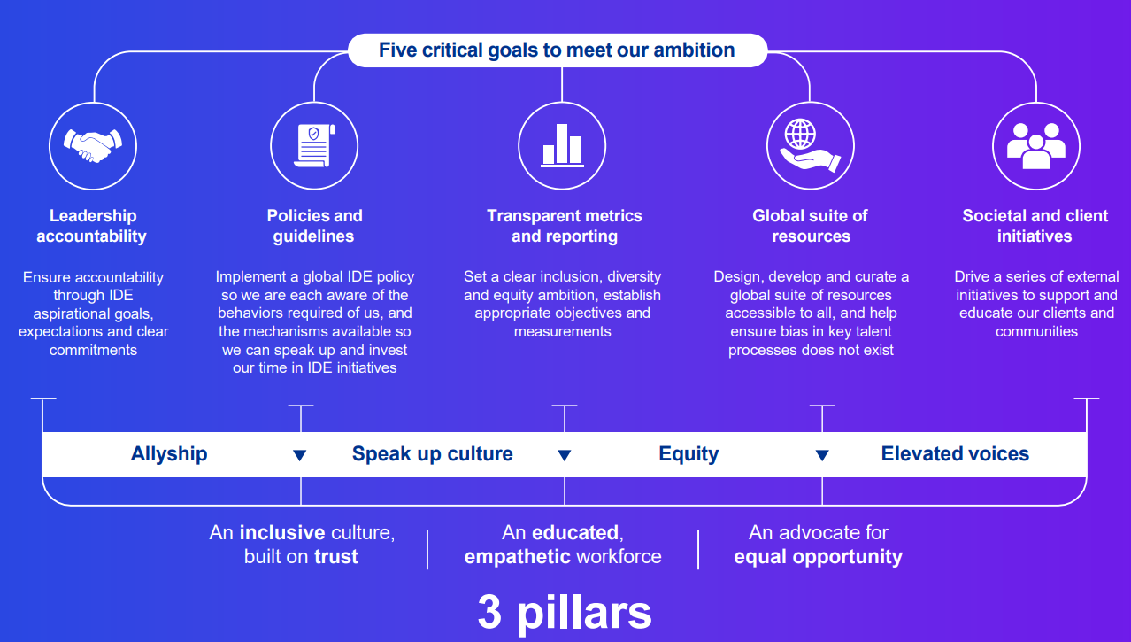

IDE Initiatives
At KPMG, the Global Inclusion, Diversity, and Equity (IDE) team works hand in hand with our Global IDE Council to execute our IDE Collective Action Plan. This plan outlines the measures KPMG is implementing to foster IDE both internally within our firm and externally within the communities we are honored to serve.
OUR EMPLOYEE RESOURCE GROUPS
ESG Benefits
SANGAM : LGBTQ+ inclusion ERG network to help LGBTQ+ person feel safe and included
EKYAM : To bring our PWD+ allies together on a platforms.
Fosters a diverse and balanced team composition.
Provides equal opportunities for all members of the workforce.
Establishes a safe and trust-based environment to support diverse groups.
AWARENESS PROGRAMS
S.H.E Leadership Series
IDE- L&D Initiatives
Say it Loud
Consulting Diversity Exit Survey2.0
Parents to be -“KILKARI”
PM Inclusion Survey
PWD/ diversity Hiring
Diversity at Manager + roles

Slide 25


Multi Geography Collaboration/ Global Delivery Model
At KPMG, we have implemented strong processes and utilize a multitude of communication tools to successfully execute projects within our Global Delivery Model. Our approach embraces and respects the diverse range of experiences, cultures, identities, skillsets, and perspectives that we collectively contribute to the KPMG community.
Local Control & Overall Delivery Accountability
Communication Tools
Offshore Delivery Centre
ESG Benefits
Encourages diversity.
Optimizes the cost of services and resources.
Utilizes the follow-the-sun model to extend support hours across different time zones.
Contributes to maintaining business continuity and operational resilience.
Geo Core Team
KPMG QE- (US/ UK/ ROW)
KGS QE
Web/Video Conferencing
TEAMS/Zoom/Webex Calls
Periodic Visits
Emails & Collaboration tools
Weekly Status Report
Daily Standups
Common Project Management Tool
LEADERSHIP TEAM
KPMG ENGAGEMENT TEAM
KPMG ENGAGEMENT TEAM
PMO TEAM
TEST MANAGEMENT OFFICE
TEST MANAGEMENT OFFICE
SMEs & Business Analysts
QE TEAM
QE TEAM
KGS Core Functional teams
Deliverables:
Requirements
Analysis & Specification
Functional Design
Configuration
Infrastructure
Testing
Training
Deployment
Release Planning
SERVICE MANAGEMENT
Deliverables:
Functional Testing
System Integration testing
Regression Testing
Automation Testing
Non-functional Testing
Issue Tracking & Resolution
Knowledge Configuration
Change Request Management
Proactive risk management
Metrics / SLAs / KPIs

Slide 26






Diversity in hiring
At our organization, we are committed to build diverse teams from the recruitment stage to the engagement process. We actively implement changes to guarantee that our teams accurately represent the diversity of our entire workforce. To support and endorse the growth of colleagues from various cultures and communities, we motivate them to participate in talent development programs and support in their success journey.
Create Diversity Recruitment Strategy
Maintain right pyramid structurefor multi generation diversity
Ensure optimal gender representation to create a truly diverse and inclusive workplace.
ESG Benefits
Fostering equal opportunities for a diverse workforce.
Boosting productivity and performance through inclusive collaboration.
Promoting increased innovation with a varied workforce, bringing forth a plethora of fresh ideas.
Ensuring compliance with Environmental, Social, and Governance (ESG) objectives and standards.
Diversity in Interview Panelists
A diverse selection of panelists is shortlisted for interviews, with the primary focus being on their skill sets, to promote an inclusive evaluation process.
Inclusive in Job Description
Create inclusive job descriptions that cater to a diverse audience, making them accessible and appealing to all, irrespective of gender or background.
Current Diversity Ratio
Team Level - Male : Female = 51%:49%
Manager + - Male : Female = 65%:35%
Diversity Recruitment Events
Conducting targeted recruitment drives focused on hiring women for senior positions and employing persons with disabilities (PWD), fostering a more inclusive and diverse workforce.

Slide 27









Focus on CSR activities
At KPMG, our commitment to Corporate Social Responsibility encourages all employees to engage in and contribute to positive societal change through environmental initiatives and philanthropic and charity events. We believe in leveraging our collective efforts to make a lasting impact on the communities we serve.
KPMG QE team members dedicate a minimum of 8 hours each towards CSR activities every year.
Inspirational and motivational talk by our leadership team to students helping them shape their career.
ESG Benefits
Provides support for both local and global communities, fostering positive change.
Enhances employee engagement in social causes, promoting a sense of purpose.
Contributes to talent attraction, development, and retention.
Elevates the company's brand and reputation through socially responsible actions.
Strengthens public and stakeholders trust and confidence.
CSR ACTIVITIES
LEADERSHIP CONNECTS
Participation in marathon events helps the team go out and stay fit while running for a cause.
VIRTUAL VOLUNTEERING
Virtual volunteering activities are conducted during pandemic and natural calamities.
MARATHON RUNS
TREE PLANTING
EDUCATION
Active participation in sapling plantation events with a key focus on environment preservation and rejuvenation.
Counseling junior college students about the opportunities they have in each STEM fields, helping them understand various career paths.
NGO VISITS
COMMUNITY EVENTS
Visiting NGO’s with differently abled people to help them build the social connect
Dedicated events conducted for KPMG QE team to participate and help the communities

Slide 28








Accessibility Testing
Accessibility testing focuses on certifying an application's adherence to standards and guidelines. Its primary goal is to ensure that the application is accessible to individuals with disabilities, providing them with equal opportunities and fostering a more inclusive society where everyone can fully participate.
QE Tools
Automation Tools: WAVE & AXE
Screen Reader : NVDA for Windows
Color Contrast Analyzer
ESG Benefits
WCAG 2.1-Conformance Levels
A—Minimal Compliance
AA—Acceptable Compliance
AAA—Optimal Compliance
Accessibility Testing is done for
Vision Impairment
Physical Impairment
Cognitive Impairment
Hearing Impairment
Learning Impairment
Compliance with regulatory standards, ensuring applications meet necessary accessibility requirements.
Facilitates equal access for people with disabilities, promoting equal opportunities for everyone in society.
Enhancing accessibility leads to an improved quality of life, fostering greater independence and fostering better social integration for all.
PERCEIVABLE
Information and user interface components must be presentable to users in ways they can perceive
OPERABLE
User interface components and navigation must be operable
UNDERSTANDABLE
Information and the operation of user interface must understandable
POUR Principles as per WCAG 2.1
ROBUST
Content must be robust enough and should be interpreted reliably by wide variety user agents including assistive technologies

Slide 29
Fairness testing
The widespread use of software systems in critical societal applications, including hiring, credit assessments, criminal justice, and disease detection, has intensified the need to address fairness concerns. By identifying and resolving these fairness bugs, we can promote a healthier Environmental-Social-Governance (ESG) ecosystem worldwide and ensure that technology contributes positively to the well-being of individuals and communities.
Core → Fairness Requirements
Examples:
Proportionate distribution between male and female
20% reservation for handicapped employees
Lawsuit narratives in specific clauses
Law judgement based on socio-political state of affairs
ESG Benefits
Unbiased software contributes to a just and significant positive impact on communities.
Cost savings by preventing expensive lawsuit settlements resulting from unfair practices.
Enhanced satisfaction and confidence in the socio-political infrastructure from improved fairness.
Promotes a resilient governance model, influencing all aspects of lifestyle by reinforcing fairness and equity.
Test Data And Machine Learning Models
Test automation models Using low code/no code, AI driven and hyper automation concepts
Fairness testing as part of SIT and UAT using offline* and online** test methods
Audit procedures by recognized external agencies
Customer Experience Lab
*Offline Testing: Testers can use historical or generated data to perform fairness testing to check whether the system meets the fairness requirements. As such data usually fail to fully represent future data, online testing is also required to test real-world application scenarios.
**Online Testing: Online testing employs run-time monitoring to keep checking whether the software can still yield fair outcomes for real-world input data. During this process, user feedback is also a common data source to detect fairness bugs.

Slide 30















UI/UX, Multi device/browser testing
To efficiently test the portals to function seamlessly across the diverse range of devices, platforms, and browsers utilized by their end-users, at KPMG, we employ the appropriate tools and techniques to optimize our testing efforts while delivering wide-ranging coverage for a myriad of devices, platforms, and browsers. Our strategic approach ensures a smooth and consistent user experience without sacrificing efficiency.
Unified Framework for Mobile application testing using BDD (Cucumber). Leverages JEST for testing JavaScript code
Cross-platform strategy for single codebase across iOS and Android, Native & Hybrid Apps
Real devices cloud like BrowserStack – Devices in a lab which clients don’t need to buy or maintain.
Centralized, easy to configure settings for the scripts to run across the environments
Supports Selenium and Appium Test Automation tool
Pro-Agile – CI enabled using Jenkins
Supports multi browser (IE, Firefox & Chrome)
Supports parallel execution on Mobile browsers and OS using public/private cloud
Customized test execution reports generated in html formats
ESG Benefits
GIT
Generic Utility Libraries
Application Specific Library
Multi-platform support creates a positive user experience.
Saves effort and cost of testing
Mandatory accessibility testing ensures usage of apps by differently abled people .
Eliminates device purchase costs and maintenance.
Energy-efficient testing practices contribute to sustainable operations.Flexibility to test emulating any geo
On demand scalability
Web Accelerators
Dialog Handlers
Config. File
Mobile Accelerators
Data Driver
Log Generators
Checkout Code from GIT
Launch script
Automated Scripts
Gradle
JENKINS
Test Controller
Object Management
Test Input Data
Reporting
Compile and Build Code and Run TestNG Tests
Devices/Browsers
Devices/Apps
under test
HTML Publisher
Automation Implementation using JEST / Cucumber / Selenium / Appium framework
KPMG Font mapper tool for UI/UX testing

Slide 31






Security Testing
At KPMG, our security and penetration testing services identify application vulnerabilities, mitigate business risks, and ensure software code meets high-quality assurance standards. By employing a combination of static and dynamic application security testing techniques, we enable enterprises to protect their digital assets from evolving security threats and maintain a robust and secure digital ecosystem.
ESG Benefits
Uphold user trust.
Protect user data and maintain privacy.
Gain valuable business insights.
Strengthens the organization's cyber-resilience.
Identify gaps in cybersecurity regulation compliance for adherence to industry standards.
Assess potential impacts and consequences of a cyber-attack.
Demonstrates real-time cyber security risks.
INFORMATION CONGREGATION
Gather information about the target system
THREAT ANALYSIS
Define scope, and
create threat profile
VULNERABILITY
ASSESSMENT
Scan for vulnerabilities using Manual / Automated process
EXPLOITATION / IN-DEPTH PENETRATION TESTING
Carry out exploitations on the validated vulnerabilities
REPORTING/ RESULT ANALYSIS
Preparation of security review reports
SECURITY TESTING SERVICES
Web Application Security Testing (WAST)
Web Services Security Testing (WSST)
Mobile Application Security Testing (MAST)
External Network Security Assessment (ENSA)
Internal Network Security Assessment (INSA)
Security Code Review
(SAST)

Slide 32






Women Empowerment
WE@Consulting is an initiative by KPMG aimed at enabling, encouraging, and empowering women in the workplace. Its goal is to promote gender equality and help create a balanced and inclusive work environment where all employees can thrive and succeed.
“WE’ @ CONSULTING
ESG Benefits
COLLABORATE AND NETWORK
Network with Senior women leaders
Collaborate to share personal and professional best practices
Strive for a balanced diversity ratio at senior levels.
Offer comprehensive support and guidance to women colleagues during significant life events, ensuring their well-being and continued career development.
Foster equity across genders.
ECOSYSTEM
Create an ecosystem for Women colleagues
Provide assistance to support their Life events, specific needs and concerns
01
05
02
COACHING
Soft skills
Management topics
ELEVATE
Identify potential women colleagues
Assist them for career growth
CELEBRATE
Celebrate success
Life events
03
04

Slide 33
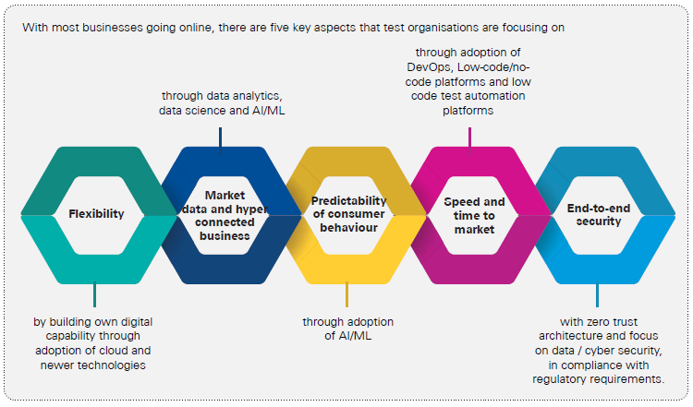





Trainings based on latest Market trends
At our organization, we strategically tailor our annual training plans by meticulously researching market trends, analyst reports, ongoing/pipeline engagements and skill gap analysis of the team as compared to the required skillset. This proactive approach enables us to maintain a highly skilled and well-prepared workforce to tackle any challenges or shifts in the industry landscape.
ESG Benefits
Training focus areas
Diversified skills in the team.
Foster a culture of learning and knowledge-sharing.
Improve workforce productivity and organizational resilience.
Deliver superior customer service.
Gain a competitive edge in the market by staying up-to-date with relevant skills and expertise.
Strengthen customer confidence, resulting in increased business opportunities and long-term partnerships.
DOMAIN
TECHNICAL
PROCESS
ANALYSTS REPORTS
ONGOING BUSINESS
Inflight projects
Pipeline projects
SOFTSKILLS
GAP ANALYSIS
Existing skillset of team
Required skillset needs

Slide 34


ESG Centric QE trainings
Providing training on ESG equips team members with a thorough understanding of pertinent environmental, social, and governance issues that impact the business, empowering them to make a positive difference. With this knowledge, a QE team member can effectively deliver ESG-focused QE services to the clients, ultimately contributing to a more sustainable and responsible business approach.
ESG Benefits
Training to provide deep exposure to ESG concepts, objectives set within the business and what it means from QE perspective
Training to provide insights into frameworks, and the skills to evaluate ESG factors within the business to ensure long term sustainability
Better understanding of ESG scenarios and priorities enables informed decision-making.
Promote reusability of components.
Implement effective program management strategies for long-term sustainability and success.
Foster a culture of innovation, quality, and continuous improvements..
Establish concise and standardized ESG reporting.
INTRODUCTION TO ESG
SUSTAINABLE STRATEGIES
ESG CENTRIC QE HUB
ESG DRIVEN INNOVATION
ESG REPORTING
Trainings on structured ESG driven Innovation process to understand ESG challenges and co-create ESG innovation solutions
Trainings to understand the ESG reporting frameworks and standards

Slide 35

GOVERNANCE IMPACT - DETAILED SLIDES

Slide 36

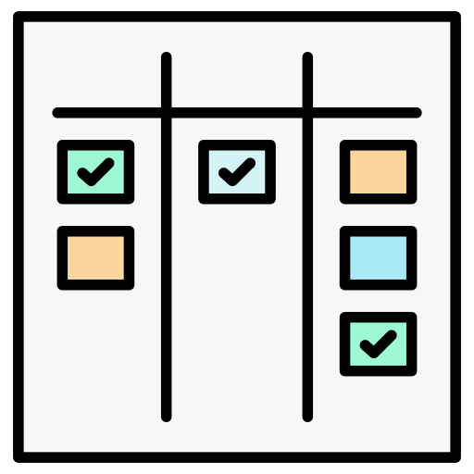
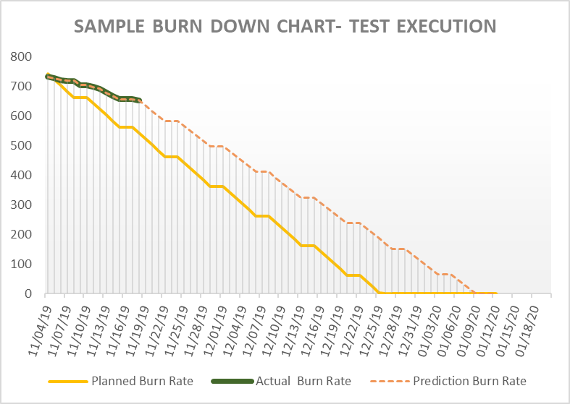










Delivery risk Predictability model
By considering the project requirements and essential inputs, we develop tailored burn down charts that forecast the potential completion date for test case design and execution. We examine the discrepancy between the planned end date and the projected end date, as well as the elements influencing the testing tasks. This allows us to proactively make informed decisions to minimize potential risks.
BURNDOWN CHART
DELIVERY RISK PREDICTION MODEL
ESG Benefits
KEY INPUTS
POTENTIAL DECISIONS
Facilitates effective project governance, ensuring smooth oversight and management.
Reduces project costs through optimized resource allocation and efficient processes.
Mitigates delivery risks, safeguarding project outcomes and timelines.
Assists in planning work-life balance for the team, supporting employee well-being and fostering a healthy workplace environment.
Scope of testing
Scope adjustment
Schedule (start date & end date)
Work on weekends & avail comp offs
TC failure rate, historical productivity
Ramp-up or ramp-down the team
Known external factors impacting QE
Risk based testing approach
Working days & holidays
Negotiate timelines
Team availability
Identify reasons for delays and address them

Slide 37






Project risk dashboard
In order to mitigate risks in projects spanning multiple locations, we have developed an in-house operational accelerator known as the "Project Status Dashboard." This tool, built on MS Access Database, enables management to monitor project risks and take proactive measures to address them, thereby earning stakeholders' trust and confidence.
KPMG Project Risk Dashboard
ESG Benefits
RISK QUESTIONNAIRE
Managers update risk questionnaires for all projects in the project dashboard across all geographical locations. Directors conduct weekly reviews of these projects to ensure proper oversight and maintain progress.
Effective governance by leadership team across all projects
Project Managers bear the responsibility of conducting project reviews, as well as tracking & assessing the health of their projects.
Gaining real-time insights into project risks allows for swift decision-making to achieve the desired outcomes.
Proactively addressing risks contributes to cost savings & reduced effort for the organization.
TIME BOUND ACTION
Project Managers carry out weekly reviews of their respective projects, focusing on addressing and mitigating risks identified in the Amber and Red status projects.
01
06
02
Projects Not updated IN PAST 7 DAYS
The dashboard provides an overview of all projects that have not been reviewed or updated within the past 7 days, allowing management to quickly identify and prioritize areas that may require attention.
PROJECTS IN RED STATUS
The dashboard presents a list of all projects in Red status, signaling critical issues or significant concerns that require immediate attention. The QE Practice Lead conducts weekly reviews of these projects to swiftly address problems and implement necessary solutions
05
03
EMAIL REMINDERS
Automatic email reminders are sent to project leads if the project status has not been updated within the past week, ensuring that necessary updates are made promptly, and information remains current.
PROJECTS IN AMBER STATUS
The dashboard displays a list of all projects in Amber status, indicating that they require special attention or may have potential issues. The QE Practice Lead conducts weekly reviews of these projects to monitor progress and address concerns effectively.
04

Slide 38







Sustainable STLC
At KPMG, we incorporate ESG considerations into our Sustainable STLC throughout various stages. These inclusions are documented in the master test strategy, with the aim of embedding a continuous focus on ESG within our organizational culture and testing processes.
1. PLANNING
Inputs from Sustainability committee/Executive
Promoting diversity and inclusivity testing to balance the biases in software algorithms, data sets, and user interfaces that may have social impact
Green IT supply chain for hardware components
Increase adoption of security testing to identify and address potential vulnerabilities
ESG Benefits
2. DESIGN
Sustainable Test architecture
Reduce dependency on on-prem data centers
Energy Proportionality: Optimize the test planning coverage/ reusable test scripting /automation to maximize the energy efficiency of hardware.
Automation Optimization: Step-by-step optimizations that increase the overall carbon efficiency by utilizing re-usable test automation solutions
Analyze/measure the ESG impact within current tools & frameworks
Reduced carbon footprint through optimum utilization of test resources
Prevention of data breach
Comply with Data & privacy regulations
Energy Efficient data transfer mechanisms
Reduction in Storage requirements
Effective Network Utilization
Promote inclusivity & Diversity
3. TEST ENVIRONMENT
Efficient & secure test data management complying with data privacy regulations
IAAS for test environment & its integration with DevOps & CI/CD
Virtualization for test data management
Automated Platform compatibility testing via cloud
Embodied Carbon: Build testing tools and applications that are hardware efficient.
4. TEST EXECUTION
NFT solutions to measure network and infra usage
Test automation for unattended testing
Automated Platform compatibility testing via cloud
Leveraging Open source & shared libraries to improve efficiencies in test script development
Incorporation of automated accessibility testing tools & higher adoption of accessibility testing
Test automation for unattended testing
5. TEST REPORTING & CLOSURE
Plan storage and transfer of test reporting/test results to cloud to minimize carbon footprint
Build/Use Test Data Management system that are carbon efficient in terms of storing and versioning (collaborative tools vs traditional tools)
Efficient & secure test data management complying with data privacy regulations

Slide 39

Controlled access for work done remotely
KPMG staff are provided with a Virtual Desktop Infrastructure (VDI) environment, enabling them to access applications, intranet sites, shared folders, and emails using the client's IT network. This setup ensures all data remains within the client's network, maintaining data security and streamlining access for KPMG staff.
ESG Benefits
Protected
Internet connectivity
Firewall
Thin clients offer faster and energy-efficient computing.
Thin clients provide enhanced data security and centralized management.
Thin clients reduce the risk of unauthorized software usage and virus introduction, promoting a safer IT environment.
Users can access their virtual desktops from home PCs, tablets, or smartphones - ensuring a secure and flexible platform for remote access.
Highly Secured
Access control
system
Only Client
Authorized
Software permitted
Restricted User
Accounts/emails
Removable
Media disabled
Workstation
Protection
through 256
AES encryption
KPMG
Client Network
Internet line
Information Security Practices
Secured LAN isolated from corporate network (no Local data storage)
Thin Client servers
KPMG Team
KPMG Firewall
KPMG Internet Link
Client VDI
To ensure utmost security, all data will reside within the client's infrastructure, and access to that data from outside the client's country is strictly prohibited without prior written consent from the client.
As a reputable accounting and professional services firm, KPMG adheres to professional standards that mandate the protection of clients' confidential information, including any entrusted personal information. In compliance with all applicable laws, including privacy laws, KPMG has implemented a comprehensive information security program to uphold its obligation to safeguard-sensitive data.

Slide 40




Controlled access - ODC
The Secured Area Delivery Model, available at KGS, caters to situations where engagement information must remain within the client's location but can be accessed by offshore personnel using restricted remote methods. Several controls are put in place to create a well-defined and secure environment, commonly known as a clean room, which ensures data protection and compliance while still allowing remote access.
ESG Benefits
The secure environment is directly connected to the end-client network, following client-specific connection protocols to maintain the highest level of security.
Ensures complete security and confidentiality of data
Nurtures and retains domain and application knowledge with dedicated core team in global delivery model
Educational, residential, and criminal background checks of employees
Signed acknowledgement of KGS policy and security requirements
Security awareness training
Timely removal of transferred and terminated employees
USB mass storage restricted
DVD/CD ROM device restricted
No administrative rights to business users
Snipping/print screen disabled
Bluetooth disabled
Laptops secured physically with locks
Only authorized software is installed
Local hard drive is encrypted: Provides data protection
Clean desk policy is implemented
Client’s clean room network is physically or virtually segregated from other KGS networks
KGS is connected to client’s network is via thin client (Citrix or VDI).
No internet access is permitted
Access to other KGS networks via wireless is restricted
All infrastructure devices are hardened to prevent unauthorized access or intrusion
Printer/Fileserver access is restricted
Restricted access to the clean room facility
Dedicated security guard at the entrance
CCTV recording: This captures the entry and exit points
Prohibition of cameras and cell phones
Administrative Controls
Desktop and Laptop controls
IT infrastructure controls
Physical security controls

Slide 41
Well defined QE metrics
There are numerous metrics available for evaluating QE engagements, and the guidance provided in the table below focuses on which metrics are most suitable for various types of engagements. While primary metrics are essential, secondary and optional metrics can enhance the measurement process but are not mandatory since the primary metrics indirectly cover them. At KPMG, we have established clear prerequisites and exception conditions for each metric to prevent any conflicts in metric evaluation.
Category | Primary metrics | Secondary metrics | Good to have metrics
Triple constraints - Time, Cost/effort, scope | Schedule Variance
 | Effort Variance
 | Requirement Stability Index
 | Cost of Quality | Cost variance
 |  | Test Case Preparation productivity
 |  | Test Case Execution productivity
 |  | Automation Scripting Productivity
 |  | Reuse
 |  | Effort saved through Automation | % Applications covered under automation
 |  |  | % Automation of Regression TCs
Defects | Defect Detection Efficiency (DDE) OR Defect leakage | Test Case Effectiveness | % of Cancelled Defects
 |  |  | Defect Rejection Rate
 |  | Test Case failure rate
 | Test cases percentage Based on Passed, blocked and failed | Defect Removal efficiency | Defect Age
 |  |  | Defects Deferred Percentage
 |  |  | Defects reopen rate
 |  | Defects by Priority
Process | Quality Gates success rate
 | Environment Availability
ESG | ESG specific metrics
ESG Benefits
Helps in efficient project governance
Helps in tracking the progress made against the targets set
ESG focus becomes part of the culture
Focus can only be given to key metrics required for the engagement thus saves effort and cost
Well defined exception conditions makes metrics easy to measure

Slide 42

Strategies aligned with market trends
In the KPMG QE practice, we adhere to the 70-20-10 rule when defining our annual strategies. This approach helps us focus on improving existing business (70%), expanding into new areas (20%), and preparing for the future (10%). By following this rule, we can effectively maintain and grow our current business while also ensuring long-term sustainability and adaptability in an ever-changing industry landscape.
Current footprint in the market
Trends based on analyst reports
Skill gap analysis in the practice
ESG Benefits
Focus on long term sustainability
Strong governance
Upskilling team based on market trends
Alignment with market needs
Business growth
Helps to be first in the market to create innovative solutions
Improves brand building and market eminence
70%
Improve the existing ➔ Align 70% of the strategic priorities based on in-flight engagements and confirmed opportunities
Go-To-Market strategies
Expand in new geos ➔ Align 20% of the strategic priorities to expand foot print in new geographies and domains
People initiatives
20%
Solution initiatives
Prepare for future ➔ Align 10% of the strategic priorities to strengthen QE delivery based on future trends
10%
Market Eminence initiatives

Slide 43
ESG inclusion in Test strategy and reporting
Incorporating ESG principles into the test strategy involves addressing Environmental, Social, and Governance factors throughout each stage of the Software Testing Life Cycle (STLC). KPMG's Master Test Strategy outlines ESG visions and principles at various phases of the STLC, ensuring that the ESG perspective is integrated right from the project planning stage. The key ESG inclusions in the test strategy are as follows:
ESG Benefits
Cloud based Energy efficient test execution
Emphasis on ESG throughout the project lifecycle
Regulation Compliance
Prevention of data breaches
Reducing resource and energy consumption
Effective resource Utilization
Saves Storage space
Inclusion and Diversity
Increased automation development
IAAS test environment with DevOps & CI/CD
On-prem dependency migration to Cloud based solutions
ESG INCLUSION IN MASTER TEST STRATEGY
Open source & shared libraries to improve TDD/BDD
Cloud-based load testing reducing energy consumption
Penetration testing to uncover security vulnerabilities
Cloud based Intelligent test management tools
Inclusive accessibility, fairness and automation testing
Details on ESG Compliance by QE team will be reported in status reports based on client requirements and targets

Slide 44

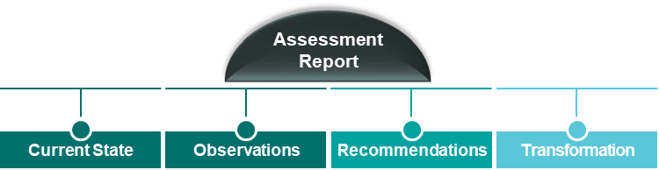

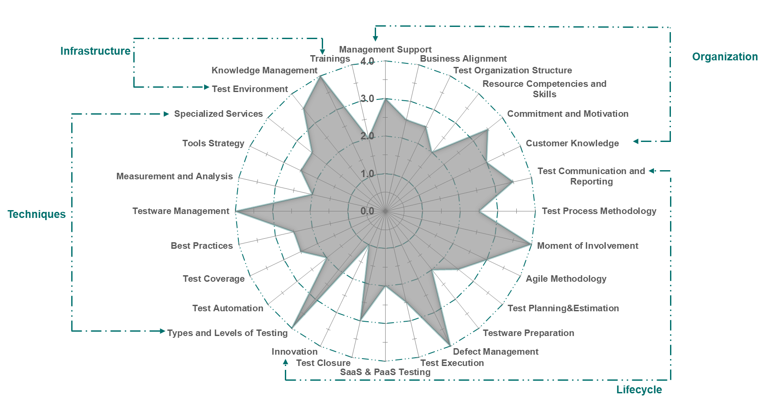
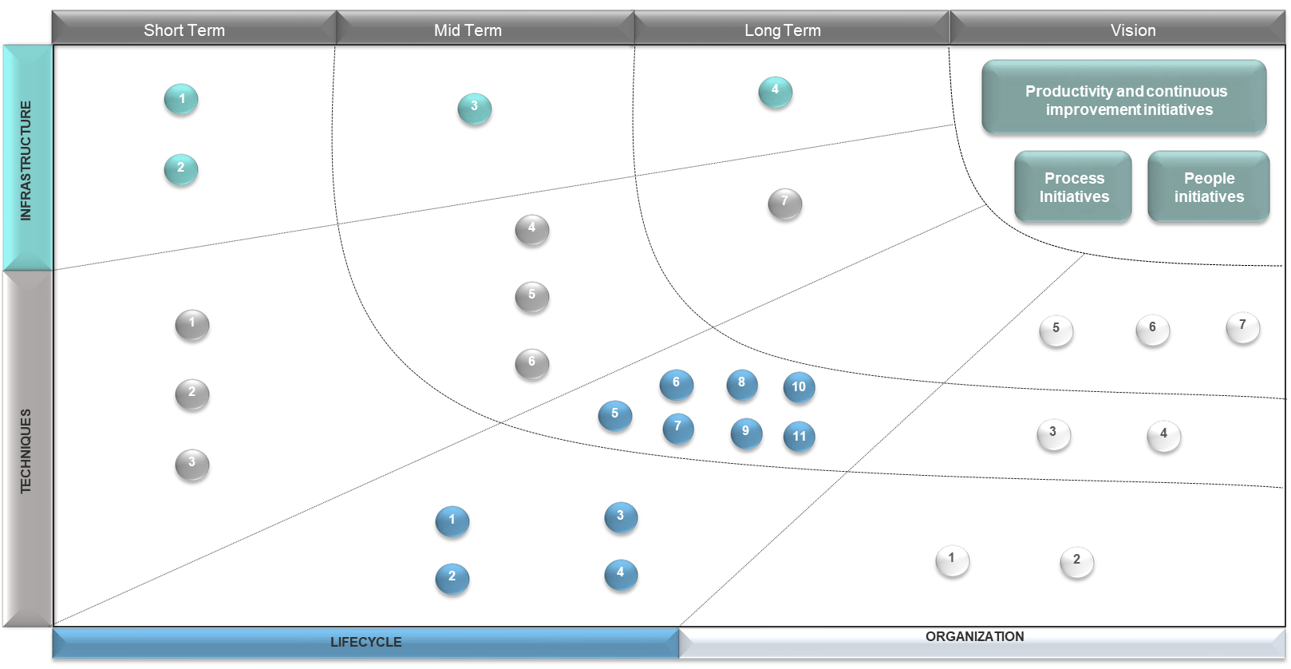
Test Maturity Assessment
We understand testing objectives and guiding principles of the organization through series of sessions with key stakeholders covering various assessment areas. Based on the observations, we offer a bold proposition that consists of both a Roadmap to reach desired Testing Maturity level, while providing Application Testing Services in accordance with client’s requirements.
Assessment Areas
ESG Benefits
Helps in better governance of Testing engagements.
Improves maturity of QE services.
Improves Stakeholders confidence.
Detailed transformation roadmap helps in continuous improvement of QE services to save effort and cost to the organization.
Organization
Lifecycle
Techniques
Infrastructure
Management Support
Business Alignment
Test Organization Structure
Resource Competencies and Skills
Commitment and Motivation
Customer Knowledge
Test Communication and Reporting
Test Process Methodology
Agile Methodology
Moment of Involvement
Test Planning & Estimation
Test ware Preparation
Test Execution
Defect Management
SaaS & PaaS Testing
Test Closure
Innovation
Types and Levels of Testing
Test Automation
Test Coverage
Best Practices
Testware Management
Measurement and Analysis
Tools Strategy
Specialized Services
Test Environment
Knowledge Management
Trainings
Includes ESG specific questionnaire

Slide 45
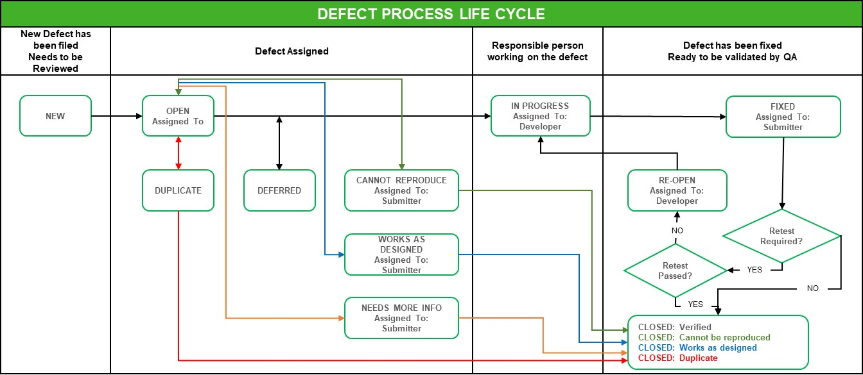
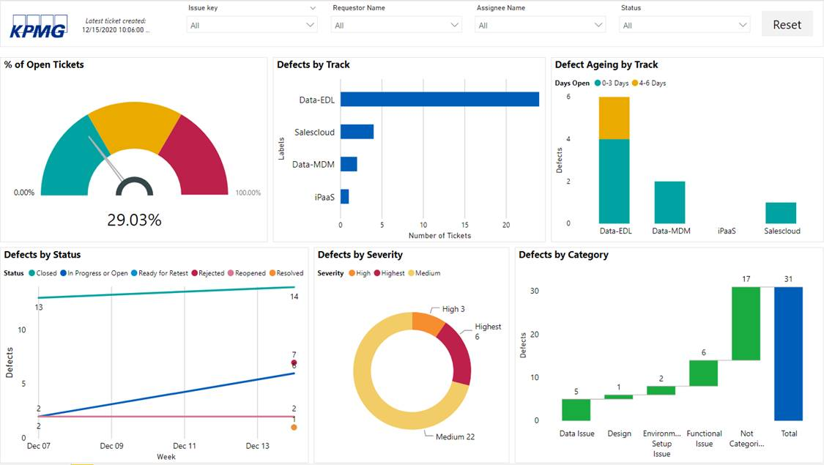
Defect Management
KPMG adheres to a robust defect management process that is compatible with a variety of defect management tools, such as JIRA, HP ALM, ADO, and others. Utilizing a standard defect triage operating model, KPMG ensures that all discovered defects are appropriately addressed in a timely fashion, in compliance with the SLAs established for specific test cycles.
Internal Review for Validity
DEFECT PROCESS LIFECYCLE
DEFECT TRIAGE OPERATING MODEL
ESG Benefits
Defects from Testing
Consistent management and review of defects arising from testing through issue management process, single common tool as repository and agreement on defect details, category, severity and priority
Effective communication channel to support development / testing collaboration
Executive level reporting of issue/ defect status for better control
Offline communication on defects back and forth between dev and testing team via the defect management tool
Development Teams
Defect Dashboard
(In defect management tool like JIRA/HPALM/ADO)
Open issues are prioritized, and discussion topics are prepared for triage meeting
Defect Review Coordinator
Updates are made in the defect management tool during the triage review
Defect Triage Board
Testing Liaisons
Defect Coordinator
Development Liaisons
Daily Dashboard Summary
Defect Severity
1- Critical
2- High
3-Medium
4- Low

Slide 46
ESG report testing
As ESG becomes a crucial focus area for organizations, the accurate reporting of ESG parameters is of paramount importance to stakeholders from a compliance perspective. QE plays a significant role in testing various ESG parameters, ensuring that the reports generated are both accurate and comprehensive. This rigorous testing process helps companies maintain their credibility and adhere to the necessary standards in terms of ES.
TESTIN G TECHNIQUES
ESG Benefits
Integration with Deal Cloud
Companies Business Information
Active & Historical Questionaries
Showcases the different calculation for a portfolio company to meet the Article obligations
Accurate reports covering all the Key parameters .
Ensure regulatory compliance across various domains.
Easily available data via real time Dashboard.
Improved Shareholder confidence.
Helps in tracking ESG progress against long term targets set at organization level.
Validate the different filters across Industry, Portfolio and Company
1
Article 9
Validate the Data fetched for a period is accurate
2
Portfolio Companies
Reports
Automated Validation of the Article 9 Calculations
3
Realtime View of Questionaries
Status View of KPI’s
Start a Questionnaire
Export Functionality
Annual Benchmark
ESG Drilldown
Period Over Period Analytics
Audit Log Validations
4
Dashboard
Validation of different ESG parameters
5

Slide 47
Thank you

